Slide 1
Application of osPCA on Data-P53 Mutants
謝幸娟 (Hsing-Chuan Hsieh)
connie0915549431@hotmail.com

Slide 2
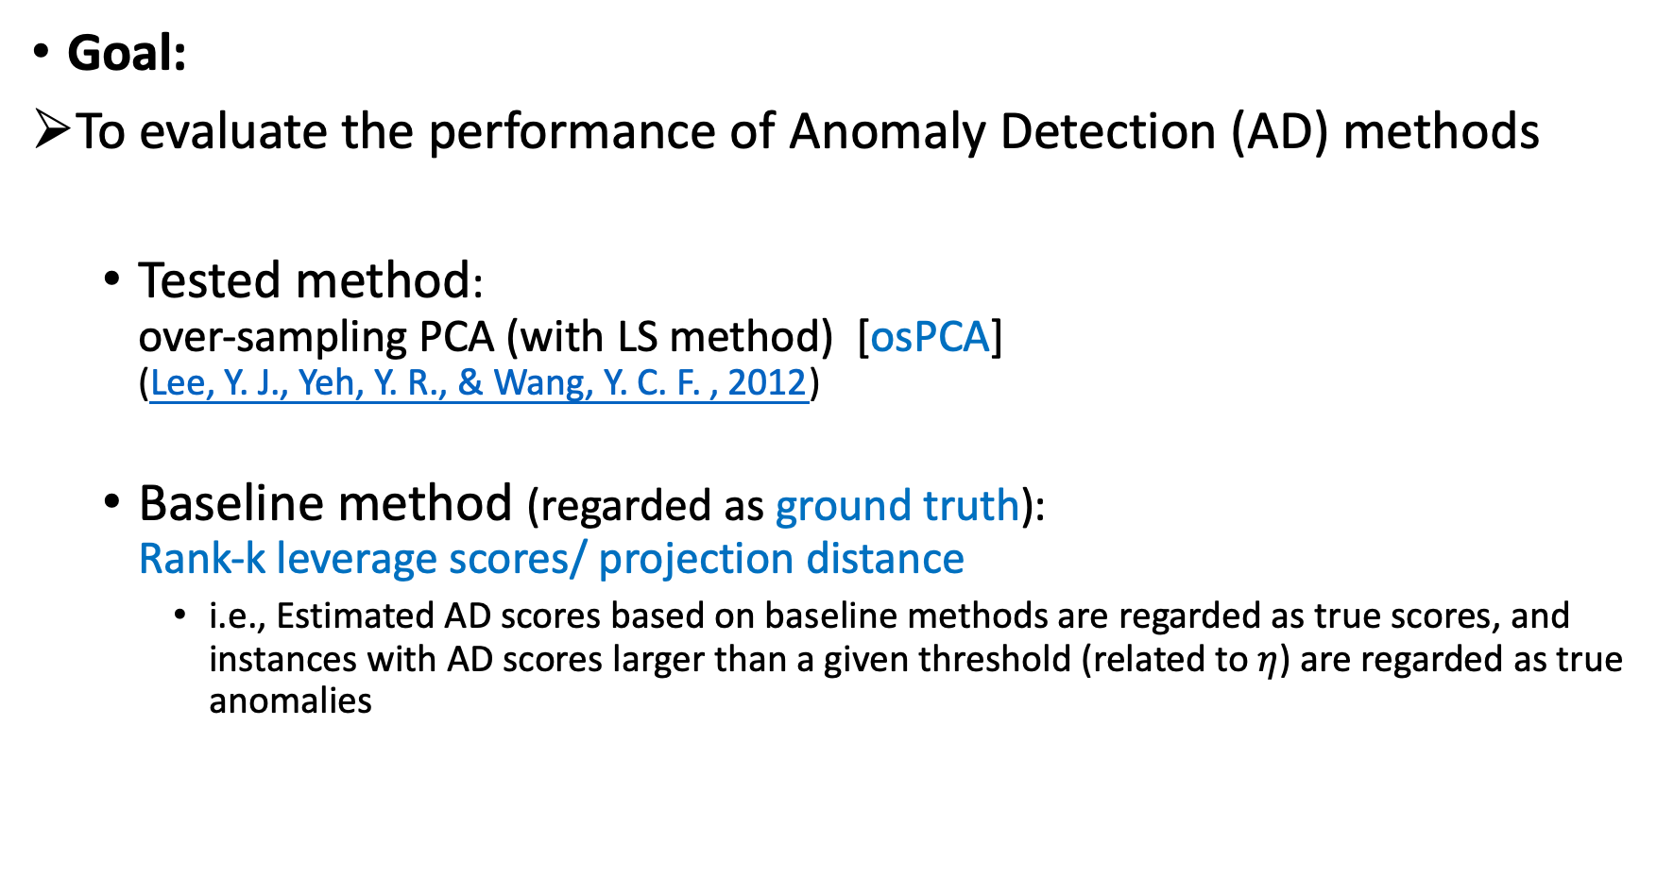
1.1. Introduction
Goal:
To evaluate the performance of Anomaly Detection (AD) methods
Tested method: over-sampling PCA (with LS method) [osPCA] (Lee, Y. J., Yeh, Y. R., & Wang, Y. C. F. , 2012)
Baseline method (regarded as ground truth): Rank-k leverage scores/ projection distance
i.e., Estimated AD scores based on baseline methods are regarded as true scores, and instances with AD scores larger than a given threshold (related to $η$) are regarded as true anomalies
Notes:
Peper:
Lee, Y. J., Yeh, Y. R., & Wang, Y. C. F. (2012). Anomaly detection via online oversampling principal component analysis. IEEE transactions on knowledge and data engineering, 25(7), 1460-1470.

Slide 3
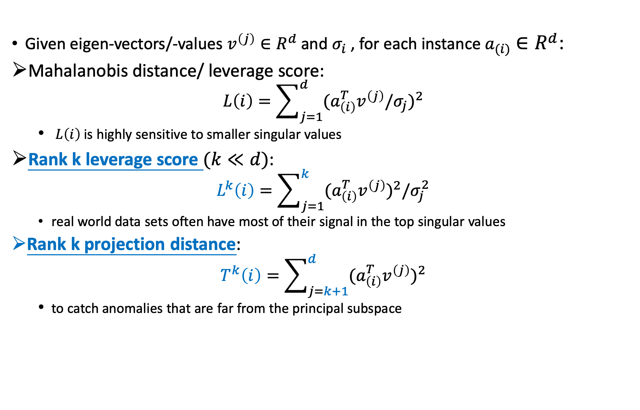
1.1. Review of Subspace-based Anomaly Scores
Given eigen-vectors/-values $v^{\left(j\right)}∈R^{d}$ and $σ_{i}$﻿, for each instance $a_{(i)}∈R^{d}$:
﻿Mahalanobis distance/ ﻿leverage score:
$$L\left(i\right)=\sum_{j=1}^{d}{{{(a}_{\left(i\right)}^{T}v^{\left(j\right)}/σ_{j})}^{2}}$$
﻿ $L\left(i\right)$ is highly sensitive to smaller singular values
﻿Rank k leverage score $(k≪d)$:
$$L^{k}\left(i\right)=\sum_{j=1}^{k}{{{(a}_{\left(i\right)}^{T}v^{\left(j\right)})}^{2}/σ_{j}^{2}}$$
real world data sets often have most of their signal in the top singular values
Rank ﻿k projection distance:
$$T^{k}\left(i\right)=\sum_{j=k+1}^{d}{{{(a}_{\left(i\right)}^{T}v^{\left(j\right)})}^{2}}$$
﻿to catch anomalies that are far from the principal subspace

Slide 4
2.1. Data
Data Source
p53 mutants
Data size: ﻿16772 (n) x 5408 (d)
Ground truth Build-up: for deciding anomalies
Accoding to the experimental design of ﻿ Sharan, V., Gopalan, P., & Wieder, U. (2018).
We compute the rand k anomaly scores using a full SVD, and then label the η fraction of points with the highest anomaly scores to be outliers.
k chosen by examining the explained variance of the datatset: ﻿typically between (10, 125)
η chosen by examining the histogram of the anomaly score; ﻿typically between (0.01, 0.1)
Notes:
Paper:
Sharan, V., Gopalan, P., & Wieder, U. (2018). Efficient anomaly detection via matrix sketching. In Advances in Neural Information Processing Systems (pp. 8069-8080).

Slide 5
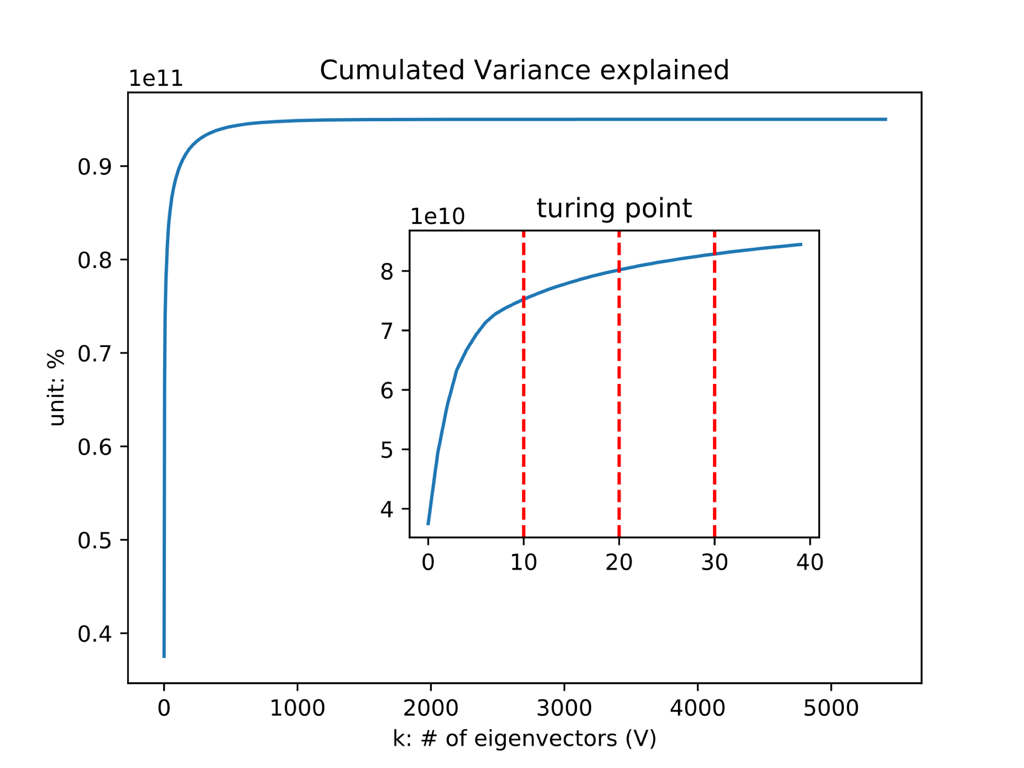
2.2. Ground Truth Build-up
Data exploration: SVD for deciding k (# of eigenvectors)
Choose K = [10, 20, 30]
The numbers are chosen the same with those in the experiment of Sharan, V., et al. (2018).

Slide 6
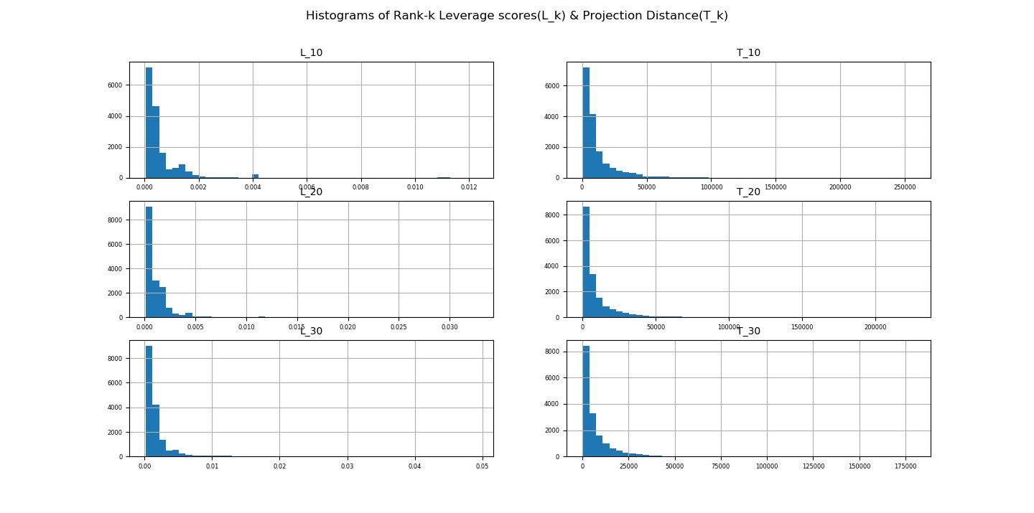
2.2. Ground Truth Build-up
Data exploration: Histograms for deciding $η$ (% of anomalies)

Slide 7
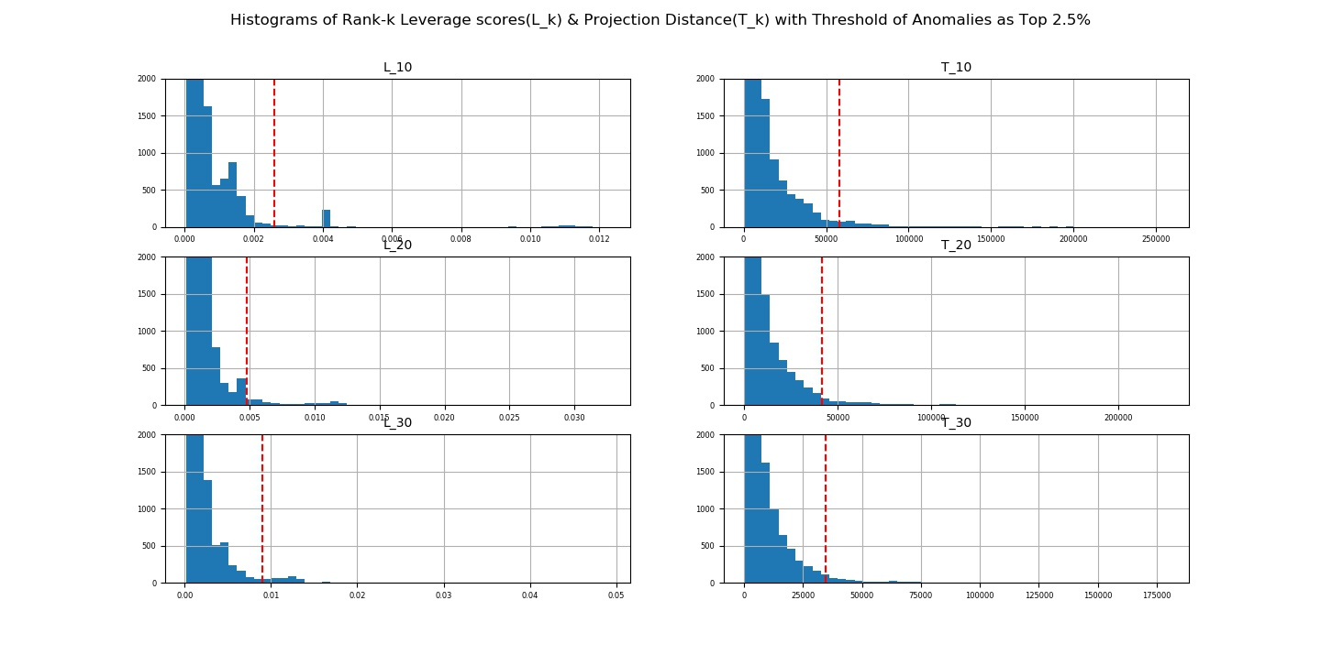
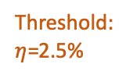

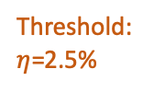



Threshold:
$η$=2.5%
Threshold:
$η$=2.5%
Threshold:
$η$=2.5%
Threshold:
$η$=2.5%
Threshold:
$η$=2.5%
Threshold:
$η$=2.5%
Through exploration, it’s decided that $η$=2.5% (i.e.#{anomalies}=415)

Slide 8
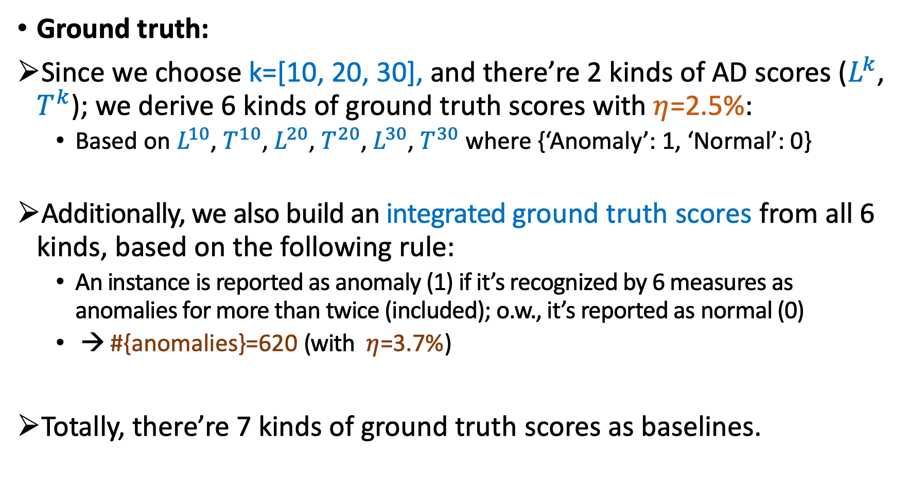
2.2. Ground Truth Build-up
Ground truth:
Since we choose k=[10, 20, 30], and there’re 2 kinds of AD scores ($L^{k}$, $T^{k}$); we derive 6 kinds of ground truth scores with $η$=2.5%:
Based on $L^{10}$, $T^{10}$, $L^{20}$, $T^{20}$, $L^{30}$, $T^{30}$ where {‘Anomaly’: 1, ‘Normal’: 0}
Additionally, we also build an integrated ground truth scores from all 6 kinds, based on the following rule:
An instance is reported as anomaly (1) if it’s recognized by 6 measures as anomalies for more than twice (included); o.w., it’s reported as normal (0)
→ #{anomalies}=620 (with ﻿ $η$=3.7%)
Totally, there’re 7 kinds of ground truth scores as baselines.
Notes:
Paper:
Sharan, V., Gopalan, P., & Wieder, U. (2018). Efficient anomaly detection via matrix sketching. In Advances in Neural Information Processing Systems (pp. 8069-8080).

Slide 9
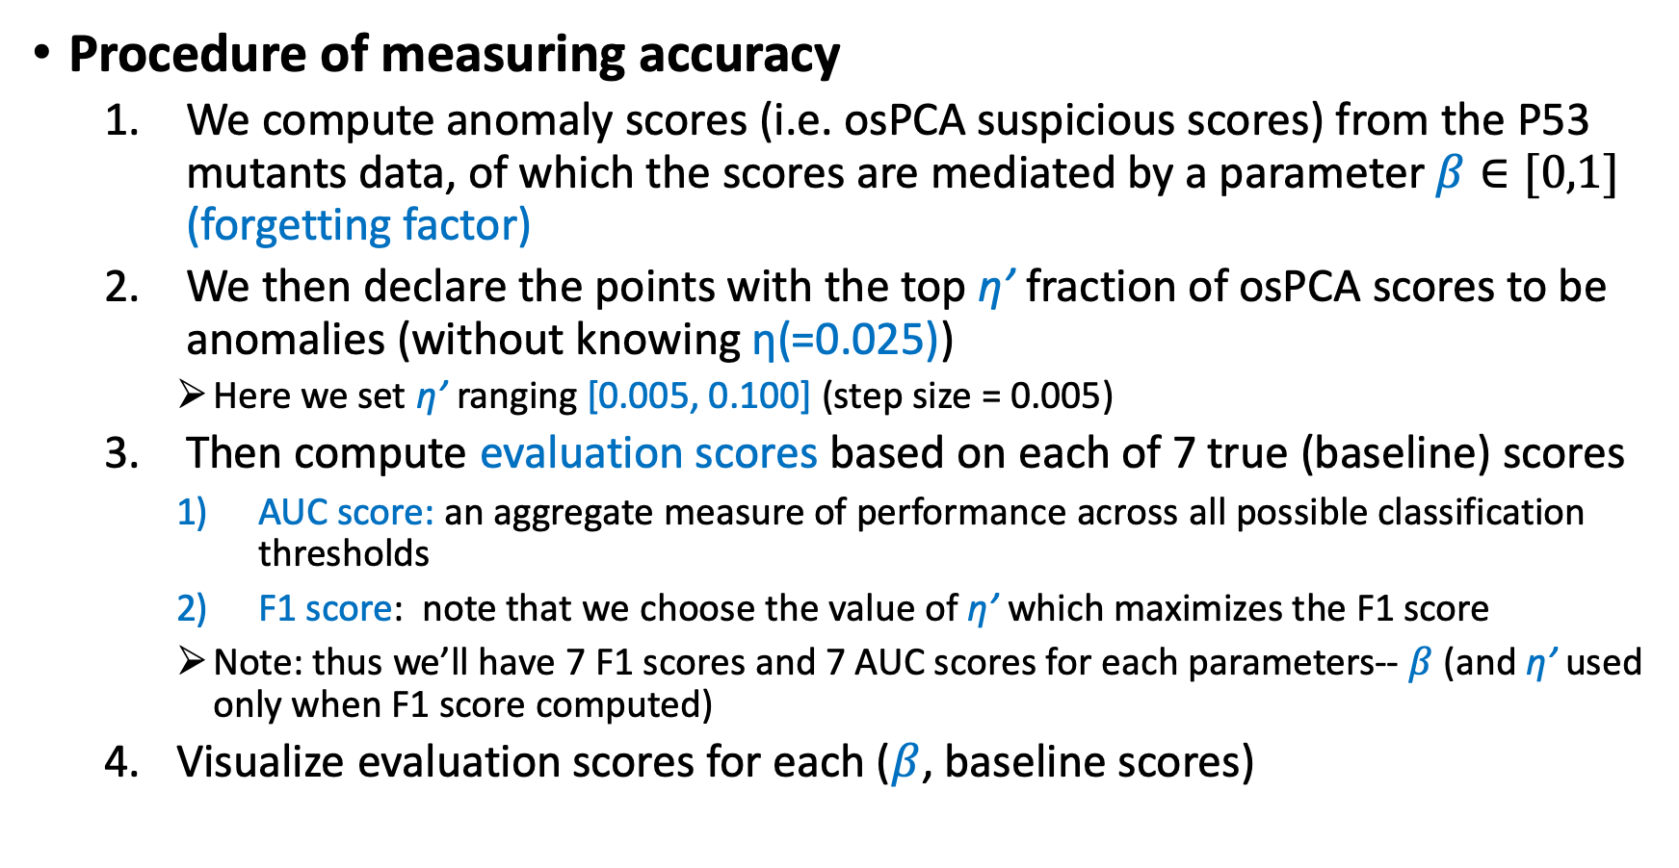
2.3. Experimental Evaluation
Procedure of measuring accuracy
We compute anomaly scores (i.e. osPCA suspicious scores) from the P53 mutants data, of which the scores are mediated by a parameter $β∈[0,1]$ (forgetting factor)
We then declare the points with the top η’ fraction of osPCA scores to be anomalies (without knowing η(=0.025))
Here we set η’ ranging [0.005, 0.100] (step size = 0.005)
Then compute evaluation scores based on each of 7 true (baseline) scores
AUC score: an aggregate measure of performance across all possible classification thresholds
F1 score: note that we choose the value of η’ which maximizes the F1 score
Note: thus we’ll have 7 F1 scores and 7 AUC scores for each parameters-- $β$(and η’ used only when F1 score computed)
Visualize evaluation scores for each ($β$, baseline scores)

Slide 10
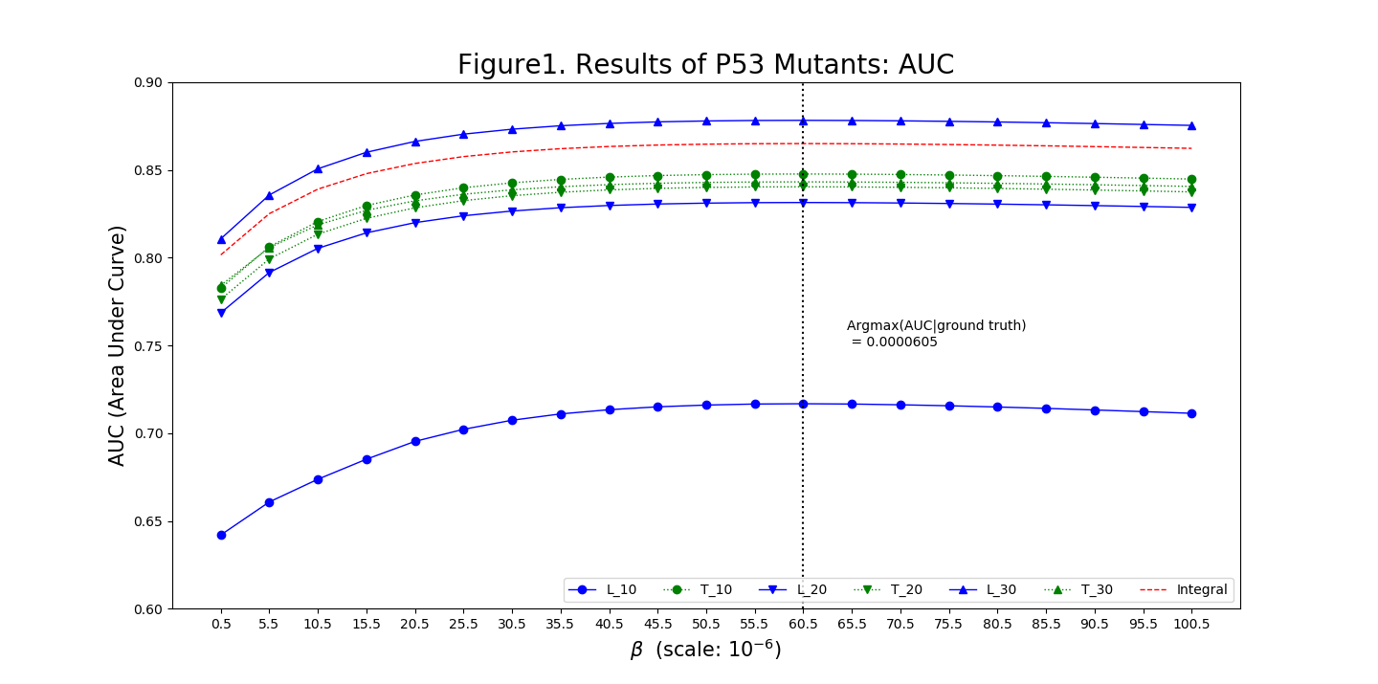
3. Results

Slide 11
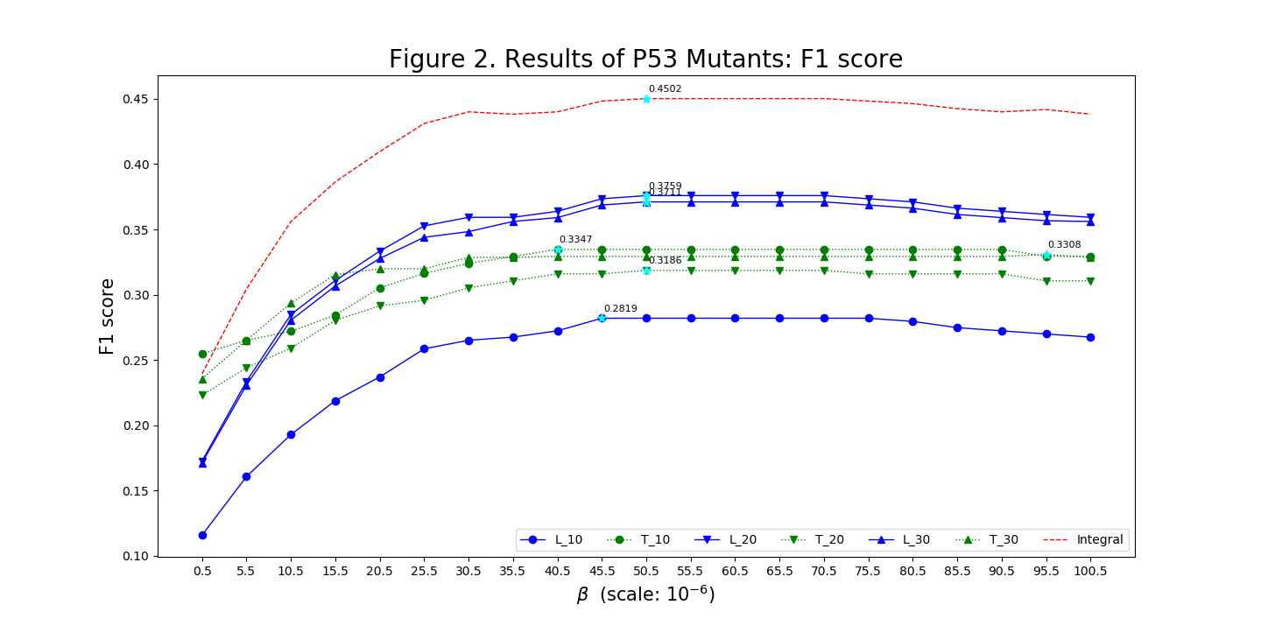
3. Results

Slide 12
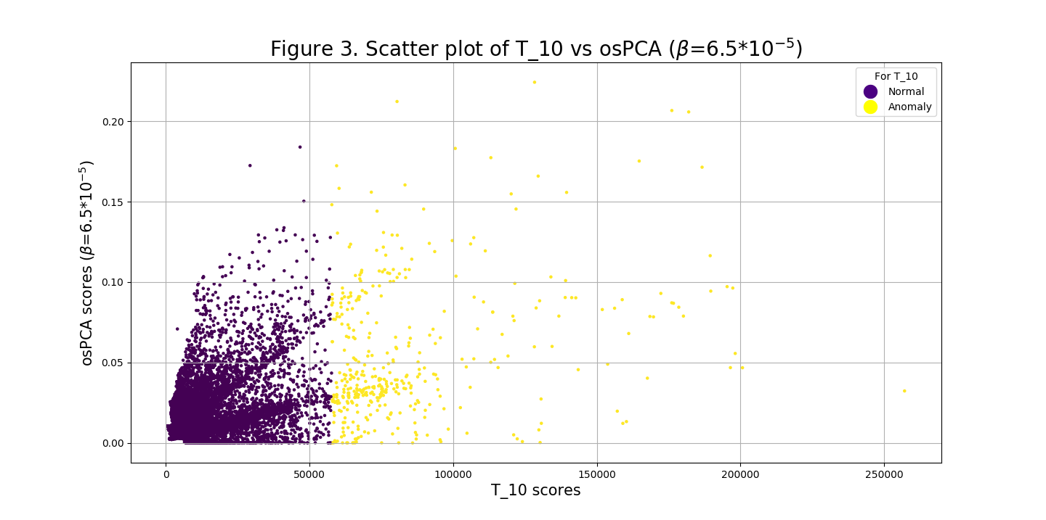
3. Results

Slide 13
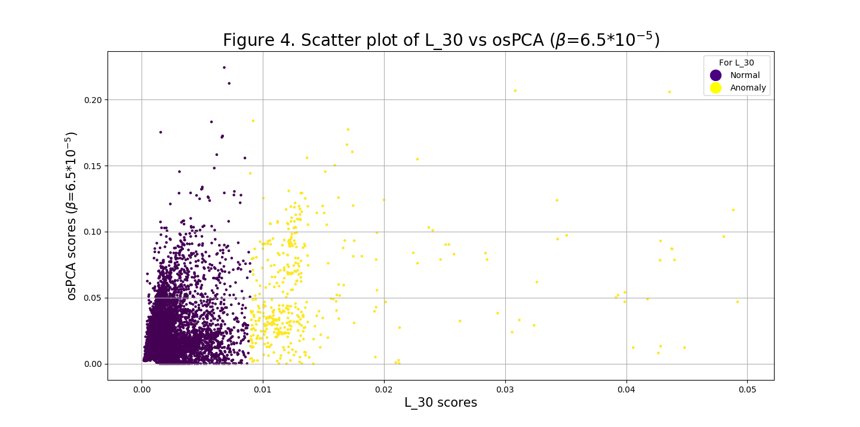
3. Results

Slide 14
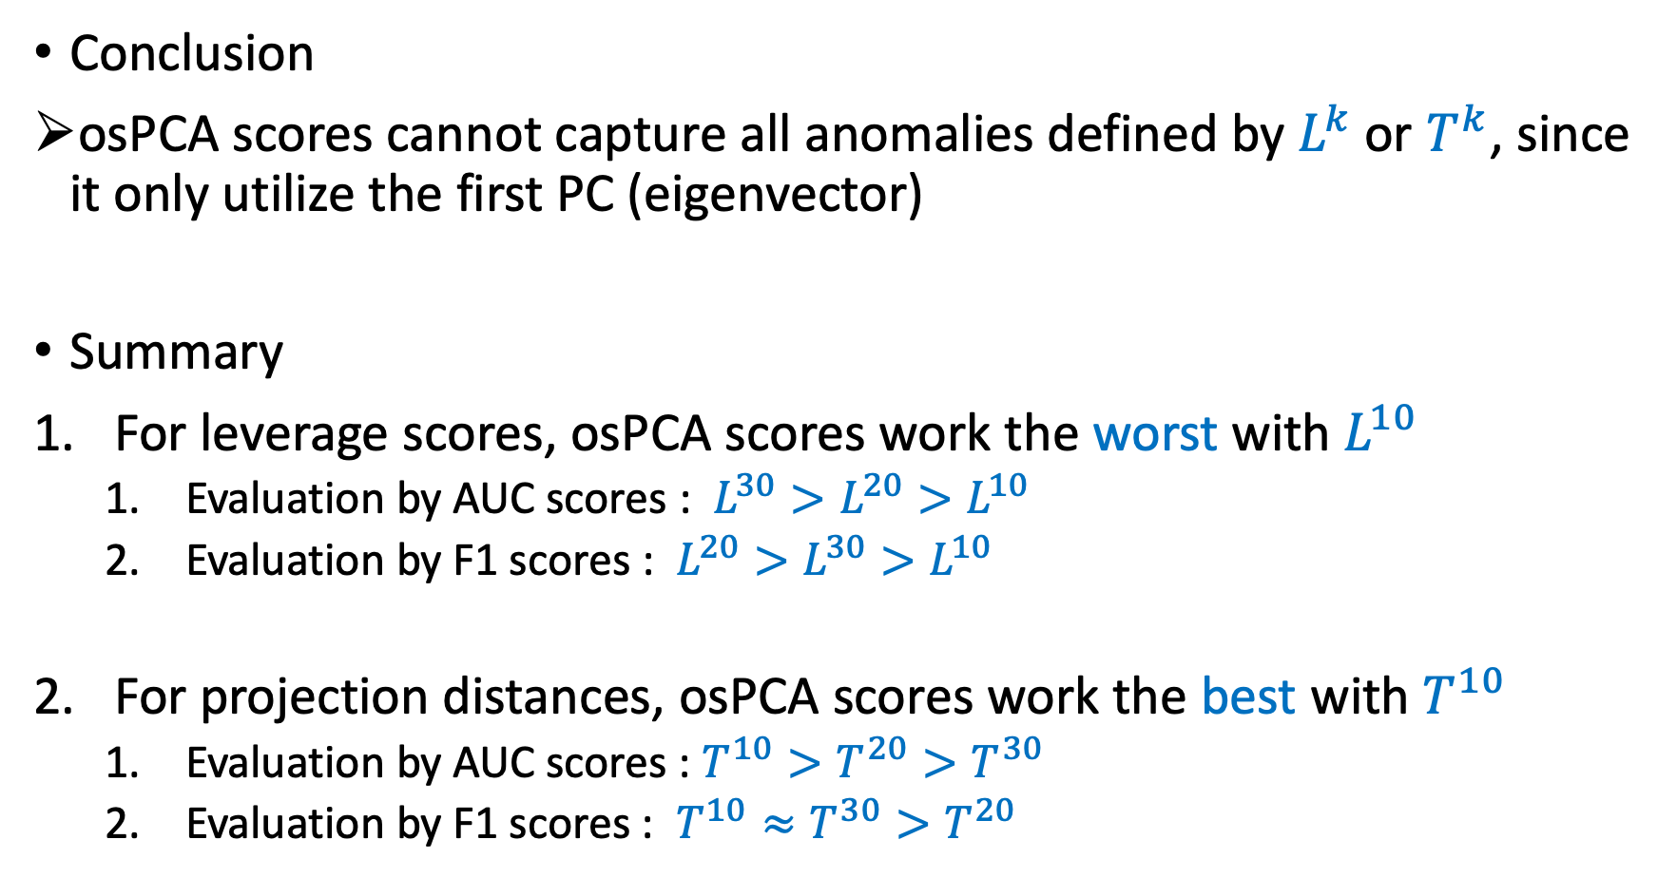
4. Conclusion
Conclusion
osPCA scores cannot capture all anomalies defined by $L^{k}$ or $T^{k}$, since it only utilize the first PC (eigenvector)
Summary
For leverage scores, osPCA scores work the worst with $L^{10}$
Evaluation by AUC scores : $L^{30}>L^{20}>L^{10}$
Evaluation by F1 scores : $L^{20}>L^{30}>L^{10}$
For projection distances, osPCA scores work the best with $T^{10}$
Evaluation by AUC scores : $T^{10}>T^{20}>T^{30}$
Evaluation by F1 scores : $T^{10}≈T^{30}>T^{20}$

Slide 15
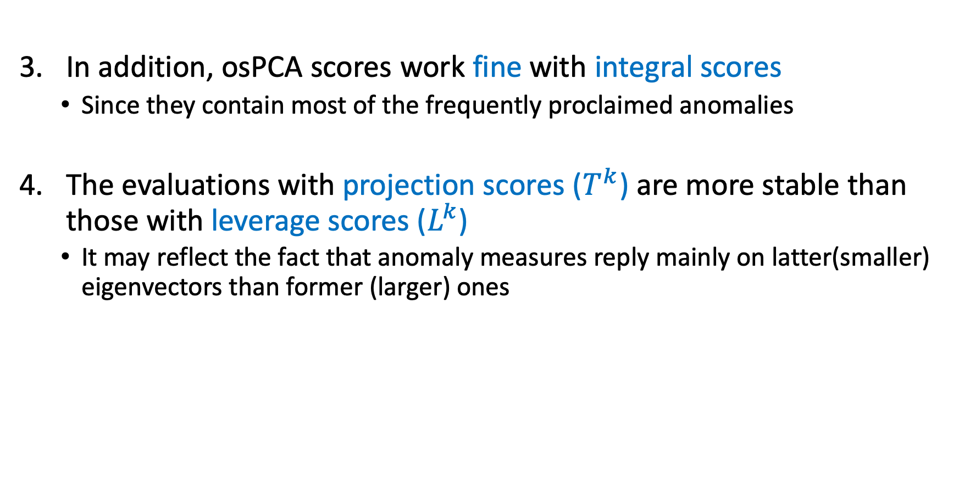
4. Conclusion
In addition, osPCA scores work fine with integral scores
Since they contain most of the frequently proclaimed anomalies
The evaluations with projection scores ($T^{k}$) are more stable than those with leverage scores ($L^{k}$)
It may reflect the fact that anomaly measures reply mainly on latter(smaller) eigenvectors than former (larger) ones

